Slide 1

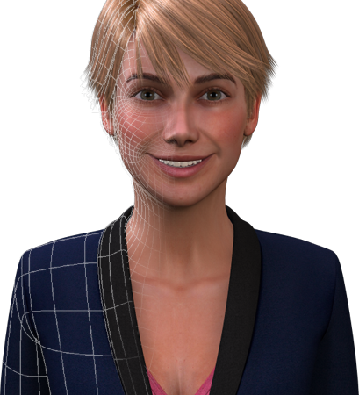
Server side
Client side
INPUT
AGENT CORE
OUTPUT
SSI
Dialogue Manager
TTS**
openSmile
Knowledge Base (KB)+
User
Agent
ASR
Rendering
Users DB***
Character
Model
eMax
Greta
ToM of User
Intent Planner
Environment
Signal Fusion
Module
HiLevel*
Signals Receiver
Behavior
Planner
LoLevel
Monitor/ Tablet
ActiveMQ
ActiveMQ
Streaming?
Monitor/ Tablet
FEEDBACK
FEEDBACK
*High Level Examples:
1) User Identification
2) Unexpected Events
e.g. incorrect user id
e.g. completed behavior
**Currently in Greta
***Needed to identify returning users
+Needed to keep track of previous interactions (history)

